Slide 1
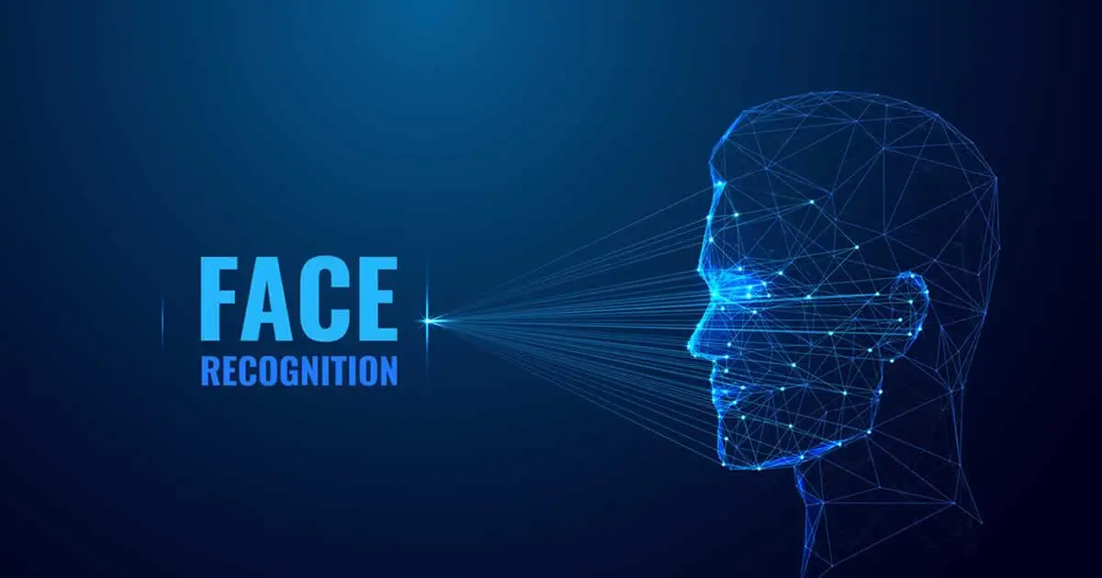
Shadow Scan AI Facial Recognition For Crime
CI2304P GROUP 6 ​
GROUP MEMBERS: RIDZ (LEADER), CELEST, JANESSA, JOANNA, YONG LI

Slide 2
Introduction
01
Our company “Cherry”
Our idea
We are a group of students who created and developed a facial recognition system for detecting crime and wanted people, therefore we can allow fast detection of people that are involved in crimes.
The Face Identification System is our answer to the intricate task of accurately identifying criminal faces. By seamlessly integrating the prowess of artificial intelligence, specifically Computer Vision.

Slide 3
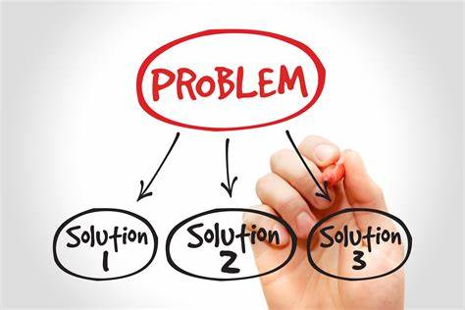
Problem
02
Persistent global crime trends are increasing. Addressing these challenges demands comprehensive strategies, so collaboration among governments, law enforcement, civil society, and international partners is vital for promoting safety, security, and justice worldwide.

Slide 4
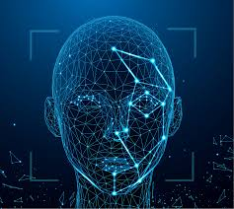
Solution
03
By employing facial recognition technology, the project aids in the detection and prevention of criminal activities by swiftly identifying individuals of interest.

Slide 5
Traction
04
"Cherry is a tech company known for innovation“
"Their products prioritize user experience."
"Design and functionality are core values."
"Cherry fosters a culture of collaboration."
"They invest in research and development."
"The company pushes technological boundaries.
"Creativity is encouraged in their work environment."
"Cherry values inclusivity and partnership."
"I would work with them again as they are reliable"

Slide 6
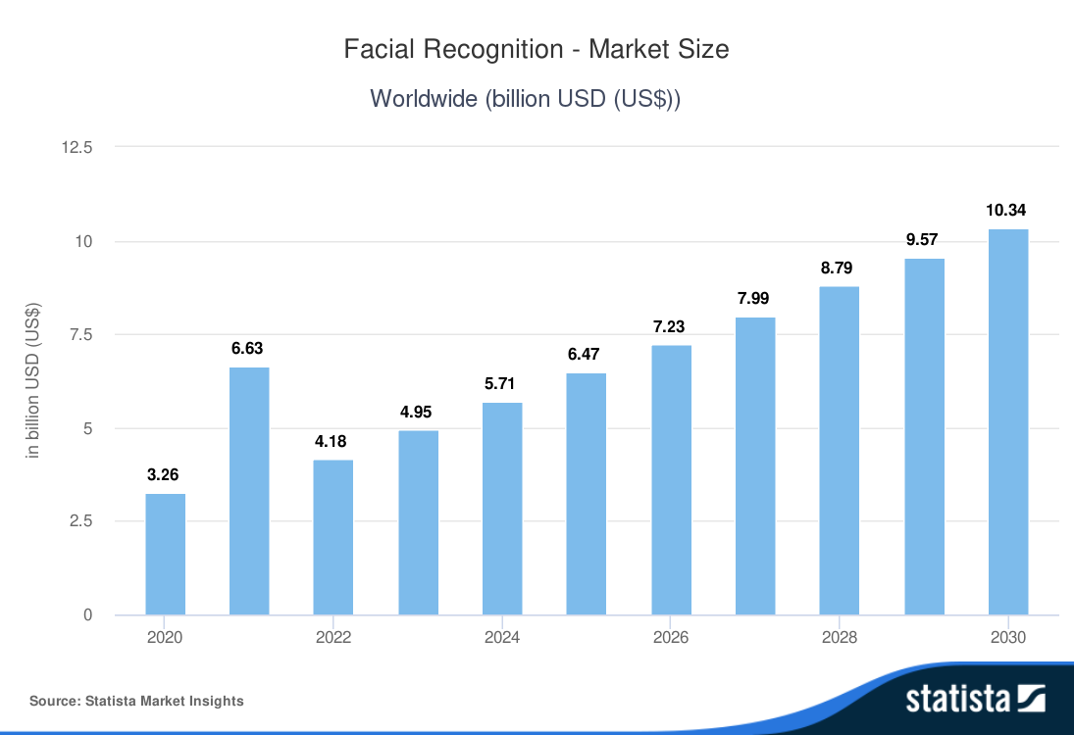
Market Size
05
The global facial recognition market is expected to see significant growth, expanding applications across industries, and growing awareness of its benefits in enhancing security, convenience, and operational efficiency. Market analysts project sustained expansion, although estimates vary based on application, region, and adoption rate.

Slide 7


Customers
06
Primary User –
Government Law
Agency

Slide 8
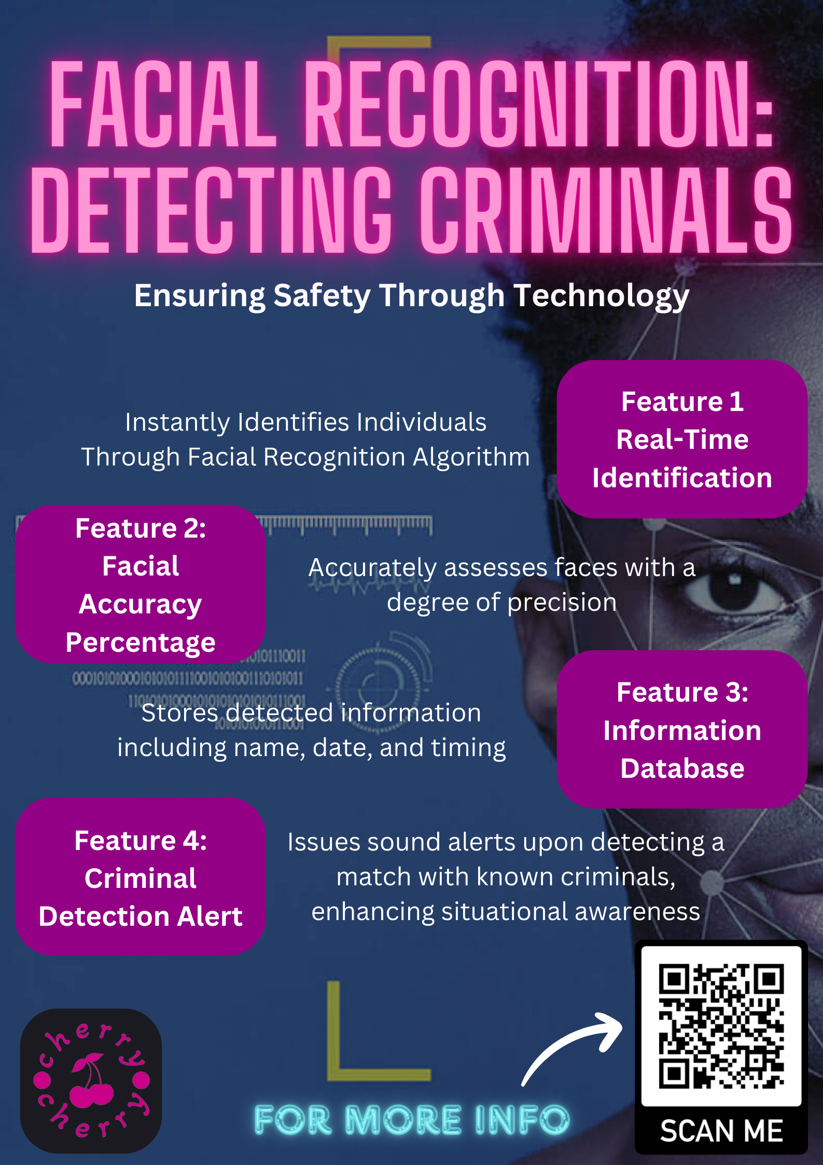
Sales Strategy
07
Promotion
Create a poster to promoting the face recognition system to capture attention and convey key information about its features and benefits.

Slide 9
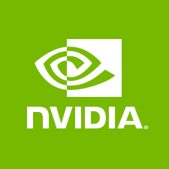


Partners
08
Google's contributions come through their expertise in machine learning frameworks and AI research. Their TensorFlow platform provides a versatile toolkit for developing and deploying machine learning models, including those used in facial recognition systems. Google's experience in natural language processing and computer vision can also offer valuable insights for refining and improving your system's capabilities.
Microsoft brings robust cloud computing infrastructure through Azure, which can support the scalability and computational demands of real-time facial recognition algorithms. Their Azure AI services also offer advanced machine learning capabilities that can enhance the accuracy and performance of the system.
NVIDIA's powerful GPU technology is instrumental in accelerating deep learning algorithms, making it well-suited for the intensive computational tasks involved in facial recognition. Their expertise in GPU-accelerated computing can significantly optimize the speed and efficiency of your system.

Slide 10
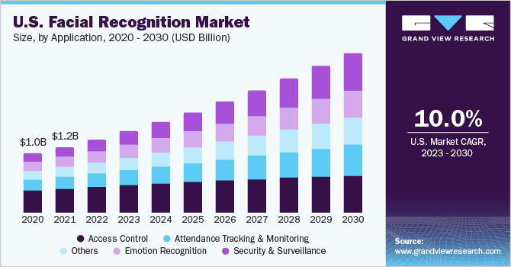
Revenue Model
09
Biometric technologies are widely employed to enhance security in applications like access control, attendance tracking, and surveillance. These technologies utilize unique and measurable characteristics such as fingerprints, iris patterns, and facial features to provide secure solutions. Facial recognition has gained popularity for its ability to detect and analyze faces using connected cameras, comparing features against stored templates in databases.

Slide 11



Competition
10
Amazon Rekognition, a deep learning-based image and video analysis service. Rekognition offers features like face detection, recognition, and analysis.
Google Cloud Vision API, which includes features such as face detection, emotion analysis, and face recognition.
IBM offers facial recognition technology through its Watson Visual Recognition service, which provides APIs for detecting and analyzing faces in images and videos.

Slide 12
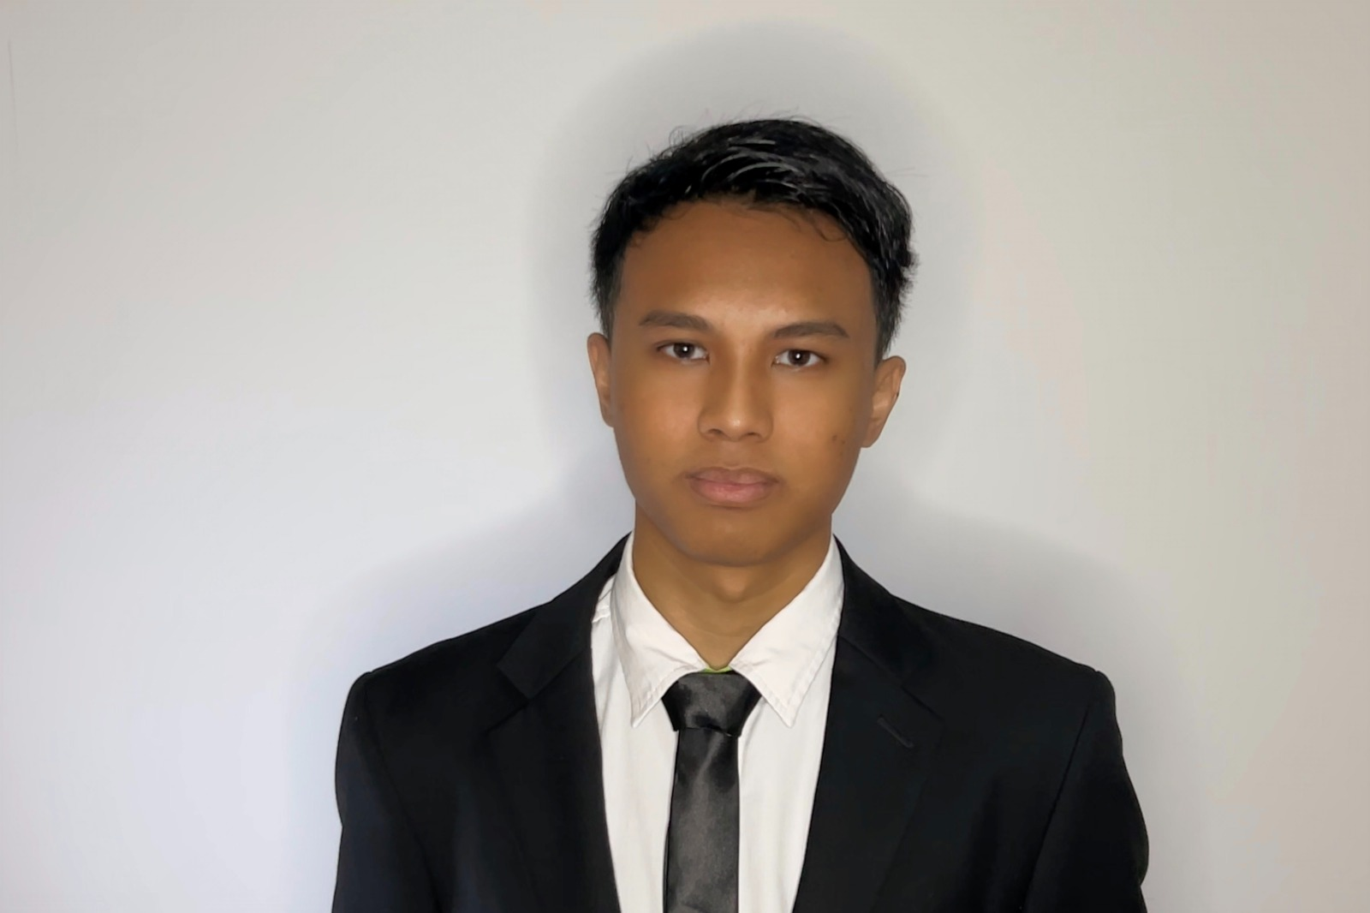
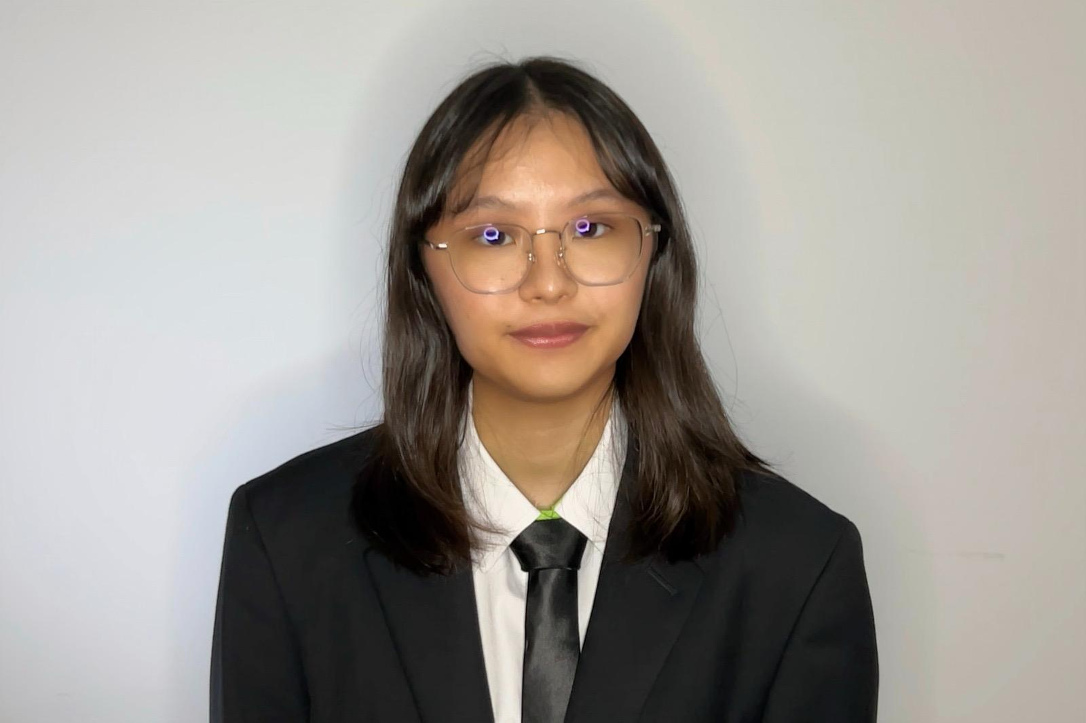
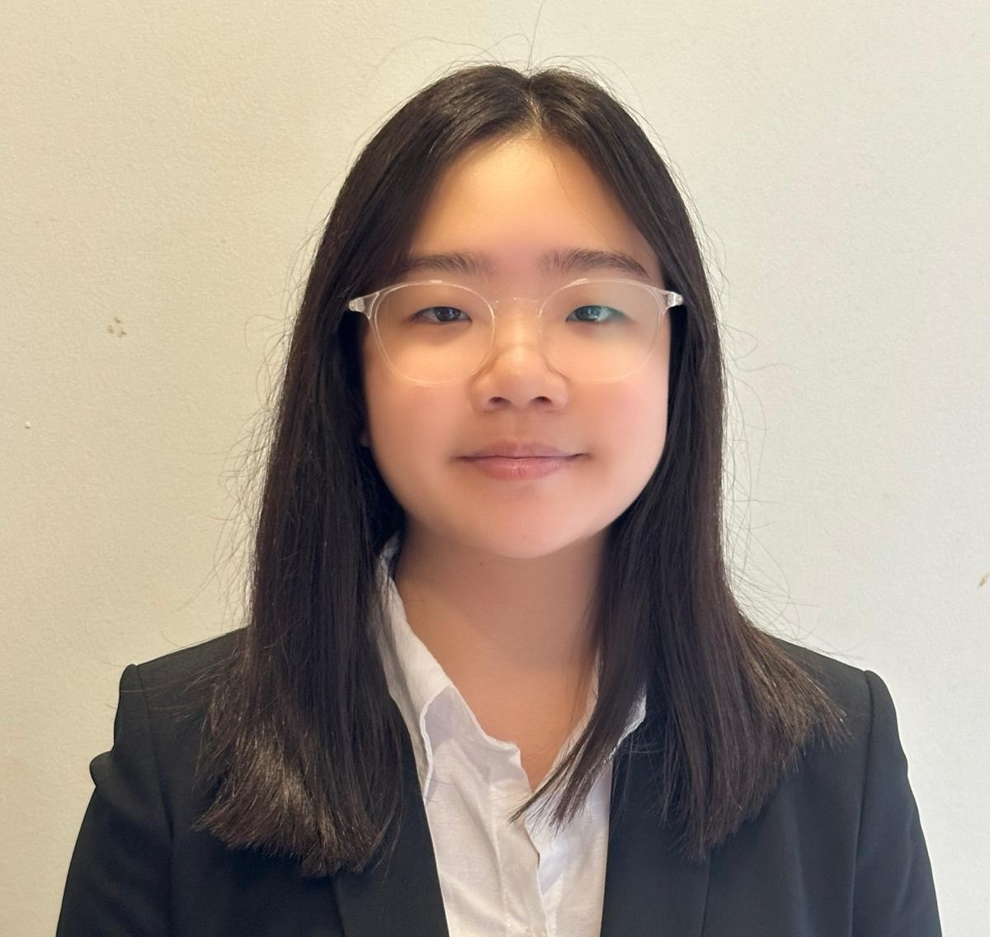

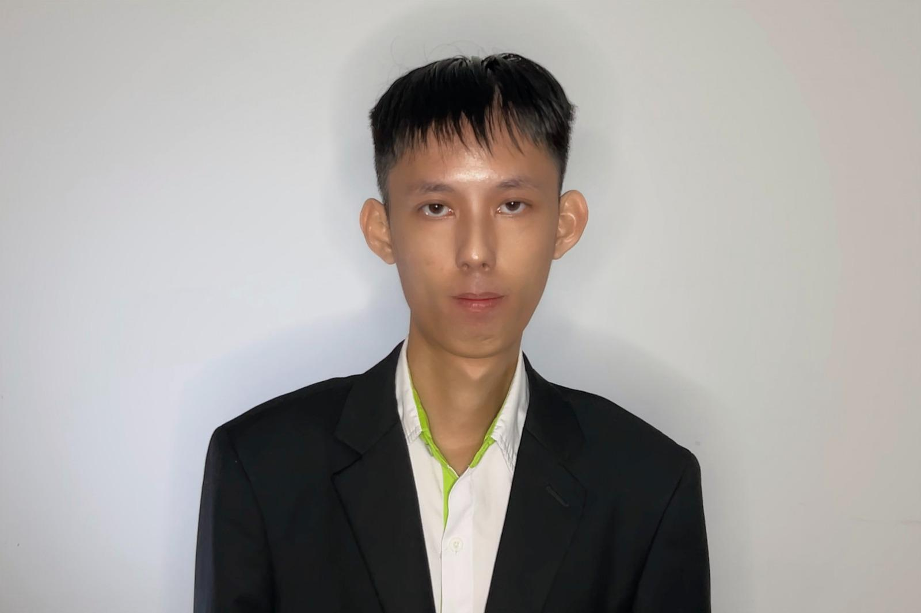
Management
11
Manager
Developer
Researcher
Systems Integrator
Tester
Muhammad Ridz
Chief Executive Officer
Celest Tham
Chief Financial Officer
Janessa
Chief Information Officer
Joanna
Chief Marketing Officer
Yong Li
Chief Data Officer

Slide 13


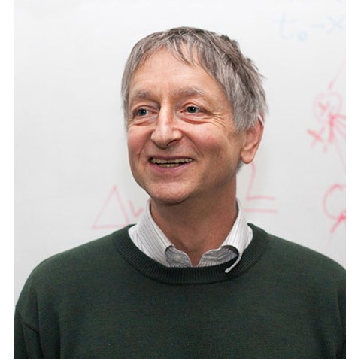
Advisory Board
12
Andrew Ng
CEO and Founder of Landing AI Co-Founder and Chairman of Coursera Adjunct Professor at Stanford University
Andrej Karpathy
Director of AI at Tesla
Currently works at OpenAI
Specializes in deep learning and computer vision
Geoffrey Everest Hinton
Vice President and Engineering Fellow at Google
Chief Scientific Adviser at the Vector Institute
Chief Scientific Adviser at the Canadian Institute for Advanced Research

Slide 14
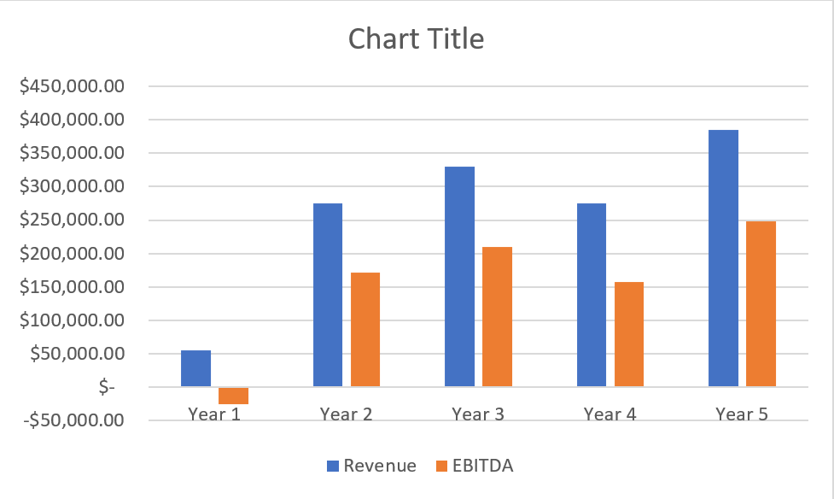
Financials
13

Slide 15
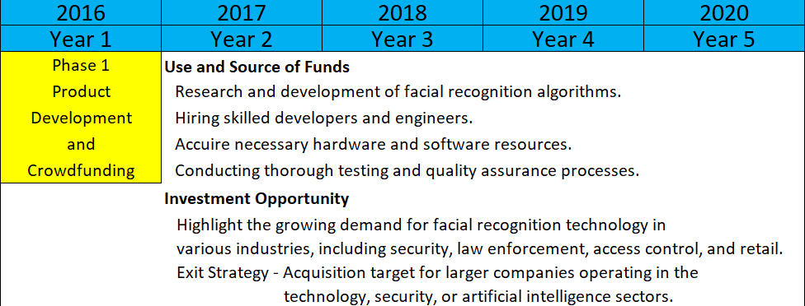
Offer to Investors
14

Slide 16

THANK YOU!!

